Slide 1
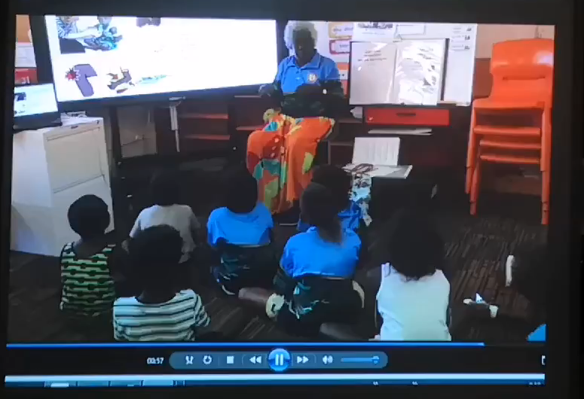







Co-designing Accessible Health Messages: Local Activities Support Global Goals
Recent work in remote areas describes the requirements for co-creation of health education resources in an appropriate cultural context – achieving inclusive and equitable quality education for all in the prevention of rheumatic heart disease (RHD).
The process below can be applied in communities where Aboriginal languages are strong and health messages need development for better understanding.
Language workers brainstorm mainstream educational materials in local languages
Emerging story using local language metaphors reworked by Aboriginal participants
Identify unclear messages by ‘testing’ story on community members
Language workers tell the RHD story in local languages using media available, activities and games
Lessons and activities for children and community are culturally appropriate
Draft story in Aboriginal language discussed
with local community development workers
Linguists check meaning of words across Aboriginal languages
Key gaps in accurate messaging identified by facilitators
Draft storyline reworked and reviewed
Artwork: Children’s interpretation of RHD and strep germ
Video: Children learn about RHD in their own language
Reference: Rheumatic Heart Disease Australia, 2018. Guidelines for producing rheumatic fever educational resources for remote settings in northern Australia: the Lurra Framework, Darwin. Author: Alice Mitchell
Acknowledgement: video courtesy of Mason Scholes, Lurra Language and Cultural Unit
Index
Do not cover this area - Do not cover this area - Do not cover this area - Do not cover this area - Do not cover this area - Do not cover this area - Do not cover this area - Do not cover this area - Do not cover this area - Do not cover this area.

