Slide 1
acuterheumaticfever
rheumaticheartdisease
anoverview
Sara Noonan
29 March 2017
SAHMRI

Slide 2
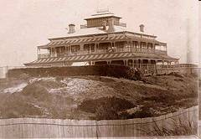
Estcourt House 1894
Adelaide, Australia

Slide 3
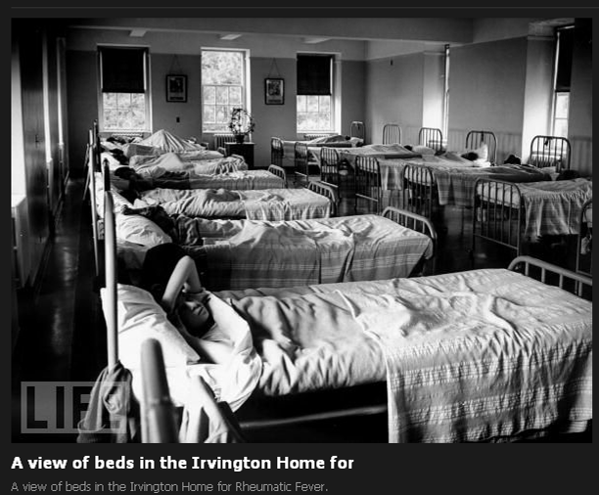
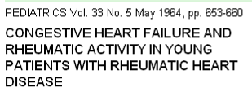
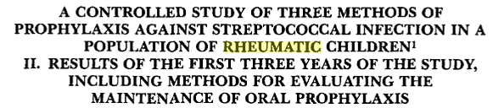
Irvington House
New York USA

Slide 4
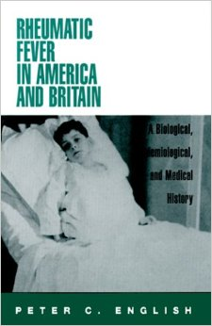

Slide 5
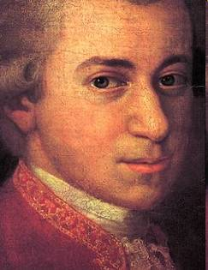
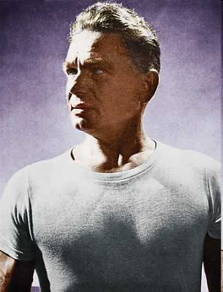

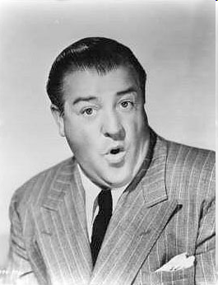




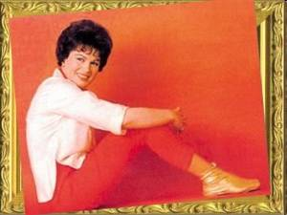
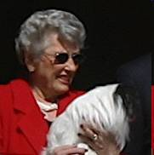

Mozart
Christopher Columbus
Andy Warhol
Joseph Pilates
Lou Costello
Bobby Darin
Robert Burns
Patsy Cline
Donald Sutherland
Princess Astrid
Kevin 07

Slide 6
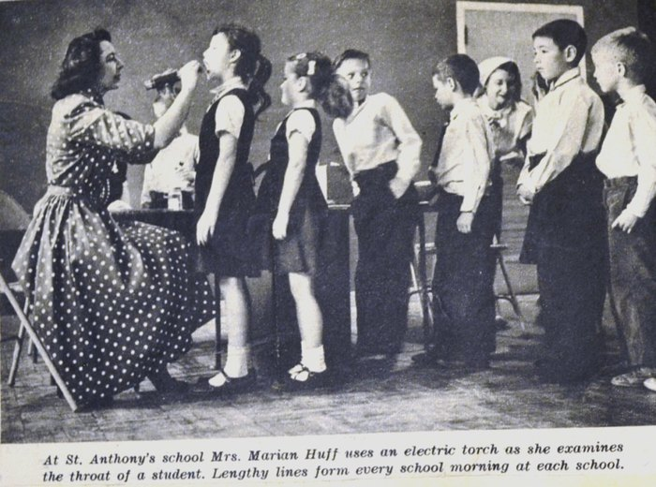
1957 (pre-antibiotic era)

Slide 7
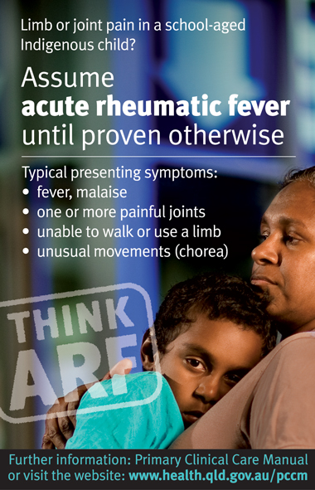
TODAY …

Slide 8
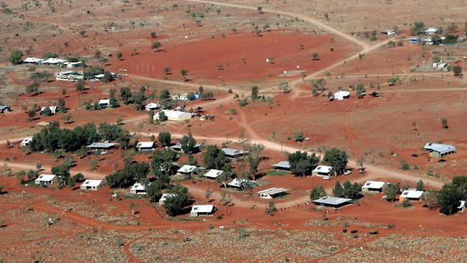

Slide 9
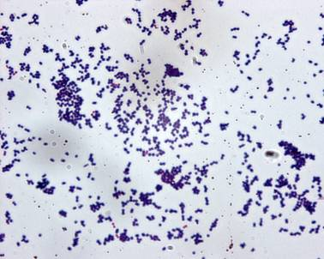
Notes:
9

Slide 10
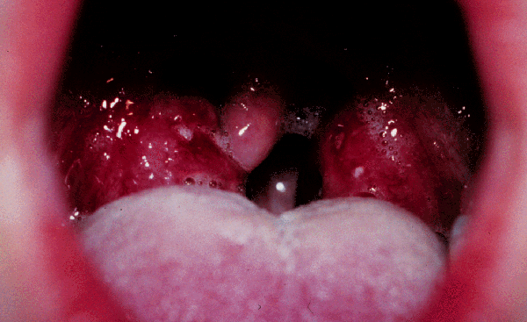
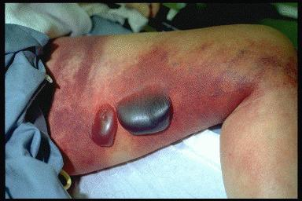
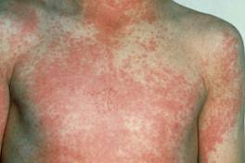
Superficial infection
  Pharyngitis
  Skin infections
Invasive diseases
  Septicaemia
  Pneumonia, osteomyelitis, etc
  Necrotising fasciitis
Toxin mediated diseases
  Scarlet fever
  Streptococcal toxic shock syndrome
Post-streptococcal autoimmune conditions
  Acute rheumatic fever
  Post-streptococcal glomerulonephritis

Slide 11
Superficial infection
  Pharyngitis
  Skin infections
Invasive diseases
  Septicaemia
  Pneumonia, osteomyelitis, etc
  Necrotising fasciitis
Toxin mediated diseases
  Scarlet fever
  Streptococcal toxic shock syndrome
Post-streptococcal autoimmune conditions
  Acute rheumatic fever
  Post-streptococcal glomerulonephritis

Slide 12
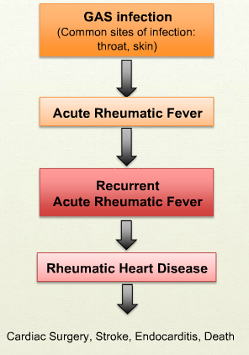

Slide 13
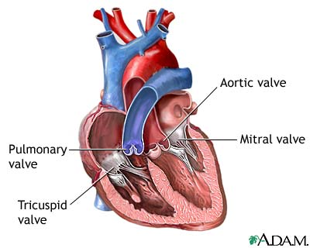

Slide 14
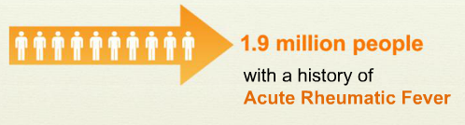


Slide 15
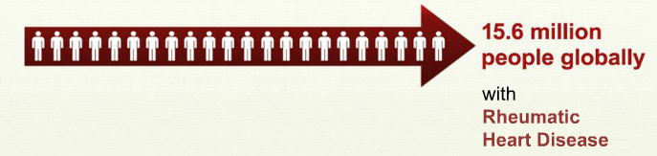
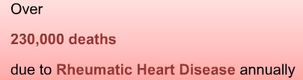

Slide 16
rheumatic heart disease …
most common
cause of heart disease in children & young adults

Slide 17
ARF – children aged 5-14 years
RHD – adults aged 35-39 years
Aboriginal 8x more likely to be hospitalised with RHD
Aboriginal 20x more likely to die from RHD

Slide 18
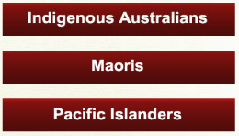
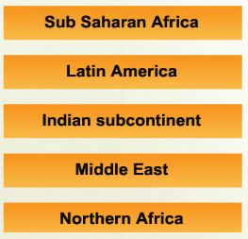
Australia
Pacific
Global
burden

Slide 19
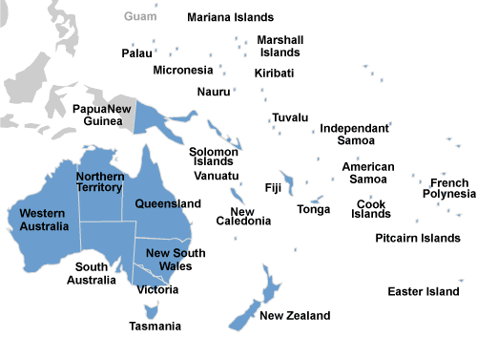
Wallis & Futuna
Tokelau
Niue

Slide 20
