Slide 1

Engaging with the heart:
Applying behavioural science to improve treatment adherence in people with Rheumatic Heart Disease
Jennifer Kemp
Clinical Psychologist
Royal Adelaide Hospital

Slide 2
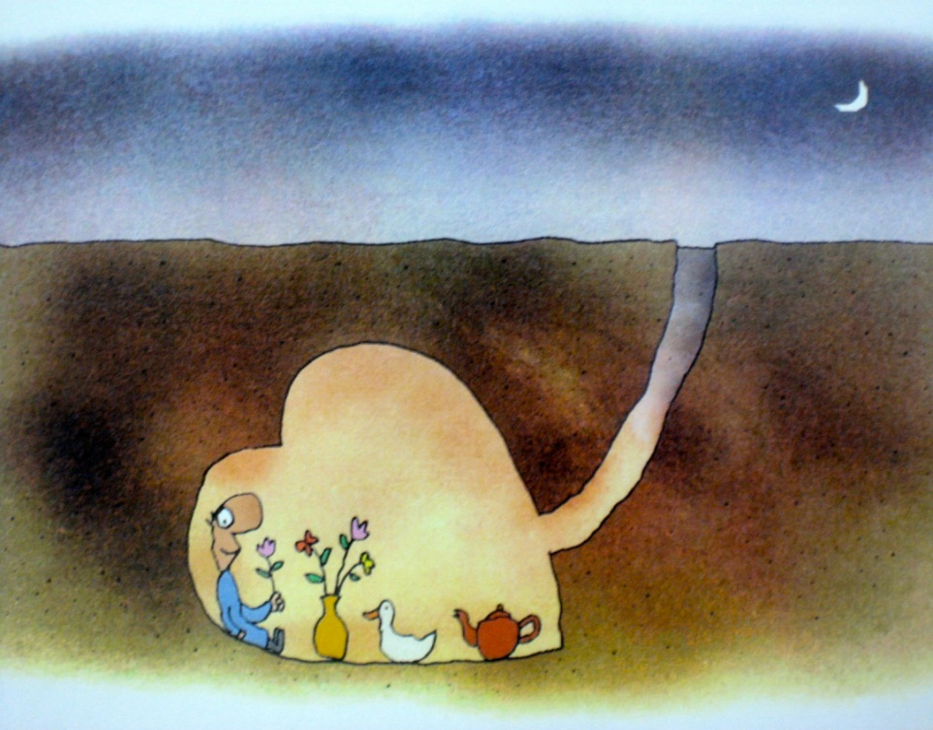
Challenges of working with people with Rheumatic Heart Disease
Disadvantage & cultural disconnection
Cynicism, disengagement, treatment fatigue, passivity, boredom, inconvenience
Prophylactic - lack of tangible
symptoms &
variable course
Notes:
Working with people with CF comes with many challenges, and many barriers to successful treatment.
As a group they can :
Cynical
Be slow to trust and build relationships with health care providers
generally disengaged
They experience pronounced treatment fatigue.
They take a long term view - staff changing every couple of years is seen as “switching all the time”
Some clients are institutionalised, passive and even dependent.
Lack of personal initiative
get used to everything being done for them
Resistant to motivational interviewing
promoted as the key to increasing adherence to treatment
Yet I’ve found very little success.
They just see right through you – they nod their head, say yes, then do nothing.

Slide 3
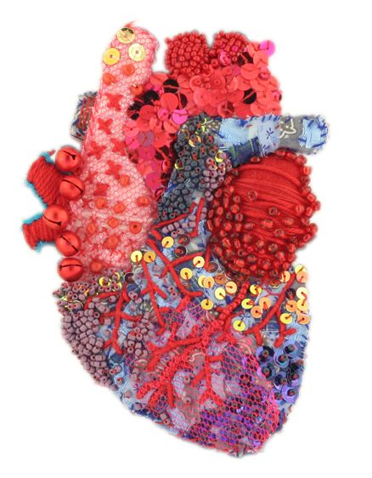
Today’s agenda
Acceptance & avoidance
Learning & reinforcement
Language & experience

Slide 4
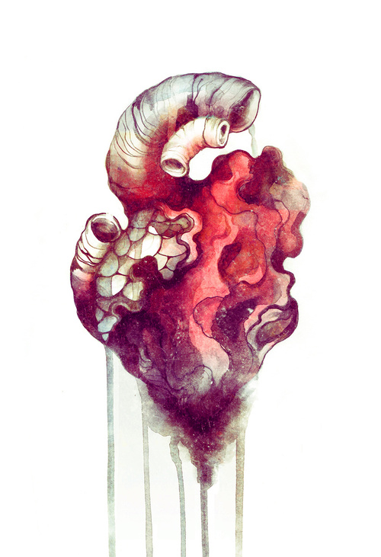
Acceptance & avoidance
Acceptance a struggle for many patients
Avoid thinking about it
Avoid physical reminders – including you and your clinic
Allows avoidance of aversive feelings (e.g. sadness, fear, helplessness, frustration)
Young people want to be ‘normal’ & get on with life
Some accept with time, others don’t
Notes:
Acceptance of risk of developing RHD would be a struggle for many patients
Those who have lower levels of acceptance will:
Avoiding thinking about it:
Who would want to think about having a shortened lifespan, chronic ill-health, gradual decline, and the impact of this on them and their goals
The will also avoid physical reminders, including treatments, and your clinic
By doing so, they avoid feelings such as fear, hopelessness, sadness, regret, anger and frustration. So there’s a pay-off.
Many seem to struggle most with acceptance during their adolescent years.
Some seem to come to terms with it, but others still don’t, well into adulthood.

Slide 5
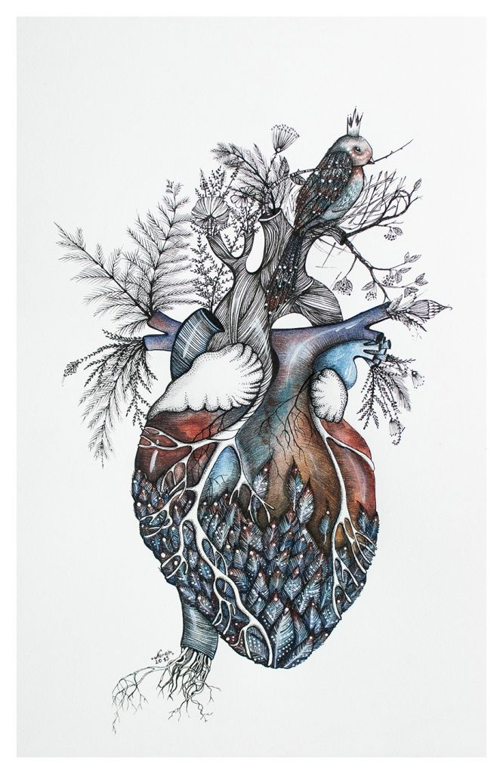
What is acceptance?
Acceptance is an internal experience where people are willing to experience difficult and aversive emotions
Your goal is to improve willingness to cope with the aversive internal experiences that the disease, and your treatment, generates

Slide 6

Acceptance & adherence
Acceptance → adherence
So how do you facilitate acceptance?
Notes:
Acceptance relates directly to how successfully patients engage with and manage the disease.

Slide 7

How can you facilitate acceptance?
Education – only part of the solution
Ask questions
  When do you find yourself wishing you didn’t have this disease?
  At what times do you pretend you don’t have this disease?
  Do you try to ignore the disease?
  Do you find yourself getting frustrated about having this disease?
  How does the treatment get in the way of your life?
Listen & acknowledge the internal struggle
Notes:
Asking such questions will give you clues about how to engage people with their disease, and how you can adapt your approach to meet their needs.
It will also strengthen your relationship and trust.

Slide 8

Language & experience
Placebo & the power of suggestion
Nocebo – when words hurt
Avoid the failure words: ‘try’ and ‘not’
  “try to keep calm” – implies
  failure and makes keeping
  calm more difficult
  “this will not hurt” → “hurt”
  “this is not painful” → “painful”

Slide 9

Predicting pain creates pain
Warning patients that a potentially painful procedure might hurt (“little sting”, “sharp scratch”) increases anticipatory pain and anxiety (e.g. Chooi, White, Tan, Dowling & Cyna, 2013)
Try:
“numbing the area”
“keep you comfortable”
“Your comfort”
(NOT “Your pain”)

Slide 10
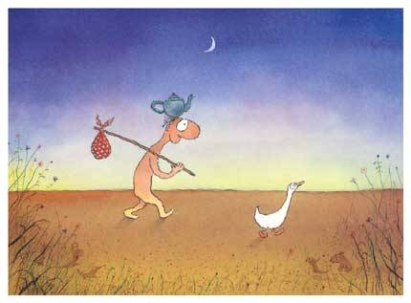
Use a metaphor
Metaphors are a powerful way to improve understanding and engagement
Can be simple: ‘your journey’, ‘steps on your path’, ‘part of the RHD family’
Should relate to the patient’s life
What metaphors would be relevant to your patient cohort?
What metaphors would be culturally relevant?

Slide 11
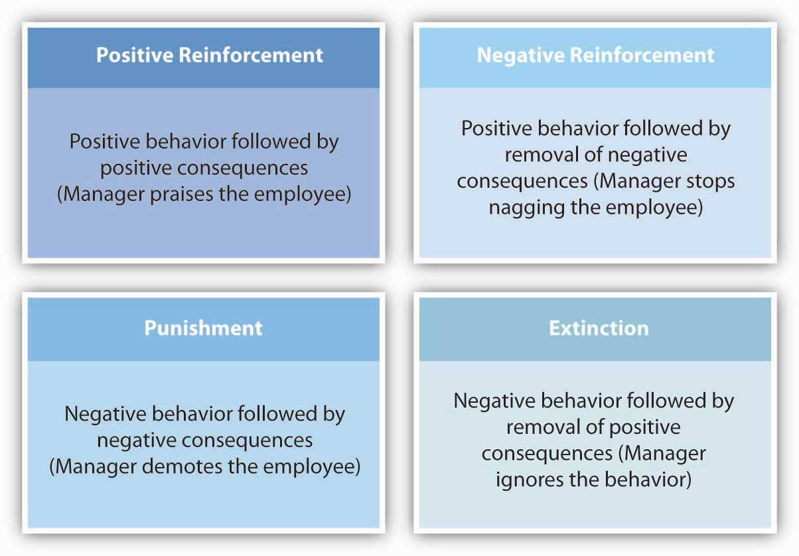
Learning & reinforcement
Consider punishment & reinforcement inherent in treatment
Incorporate positive reinforcement into the treatment
Remember that reinforcers need to be temporally close
Focus on short term gains not just long term health
Notes:
Consider punishment & negative reinforcement inherent in certain treatments
Incorporate positive and negative reinforcement into the treatment.
Positive reinforcement
e.g. What can they cope with now, that will build successes (and therefore be positively reinforcing)
e.g. What treatments will give short term positive impacts (and therefore be positively reinforcing)
Negative reinforcement
e.g. What treatments will lead to a noticeable, short-term decrease in negative outcomes

Slide 12

Using reinforcement to support adherence
Consider YOU as the vehicle for reinforcement and change
Your encouragement, your validation are key positive reinforcers
The stronger your relationship with the patient, the greater impact of the reinforcement and the greater likelihood of change
Notes:
Consider YOU as a vehicle for that reinforcement – your encouragement, your validation of the patient’s efforts (no matter how small) are critical
The research is unequivocal that the stronger your relationship with the patient, the more influence you will have, and the more effective the reinforcement will be.
By developing the relationship and trust, you will have a much greater influence over the patient’s health care choices.

Slide 13

Recommendations
Acceptance of the issue is crucial to adherence and can be improved over time through conversation
The language you use can define the patient experience is critical

Slide 14
Recommendations
Consider the reinforcers in your treatment – positive & immediate, not long term
Use yourself as the agent of reinforcement: be intentional and thoughtfully reward, recognise, validate, encourage and build mutual trust

Slide 15
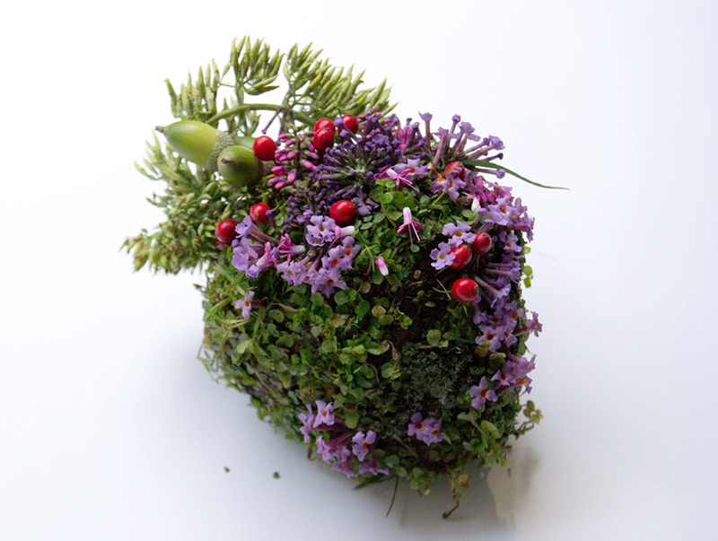
Thank you
jennifer.kemp2@sa.gov.au

