Slide 1
Diagnosis & management
Acute rheumatic fever
Sara Noonan
29 March 2017
SAHMRI

Slide 2
page 32

Slide 4
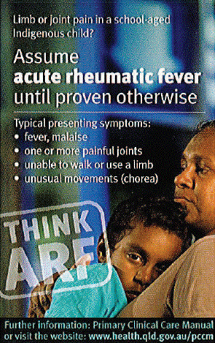
arthritis
Most common - more than 75% cases
Most difficult to diagnose

Slide 5
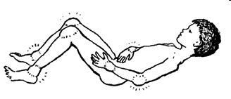
arthritis
Poly-arthritis – migratory, but may be additive
Pain, inflammation, heat
Asymmetrical
Large joints (knees, ankles, elbows, wrists, shoulders, hips)
Pain (often out of proportion to clinical signs)
Very sensitive to NSAIDs
** If untreated each joint lasts about 2 weeks **

Slide 6
carditis
Inflammation of the heart valves (valvulitis)
Pericarditis & myocarditis do occur
Clinical signs
    Heart murmur
    Cardiomegaly
    Chest pain
** Almost all recurrent ARF includes carditis **

Slide 7
Sydenhams chorea
Seen in approximately 25% cases
Affects one or both sides of the body
Involves hands, feet, face, tongue
Symptoms disappear during sleep
May occur late after streptococcal infection up to 7mths
More common in adolescent girls
May recur in pregnancy
** Chorea has a high association with carditis –
echocardiogram is recommended **

Slide 8
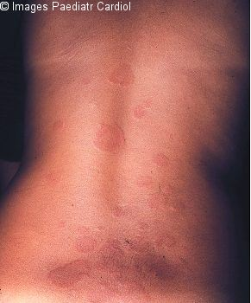
erythema marginatum
Highly specific for ARF
Seen in less than 2% cases
Pink macules or papules that go pale under pressure
Not itchy or painful
On trunk and limbs, rarely on face
May be hard to identify on dark skin

Slide 9

subcutaneous nodules
Highly specific for ARF
Seen in less than 2% cases
0.5-2cm nodules - round, mobile, firm, painless
Over the elbows, wrists, knees, ankles, spine
** Nodules have a high association with carditis –
echocardiogram is recommended **

Slide 11
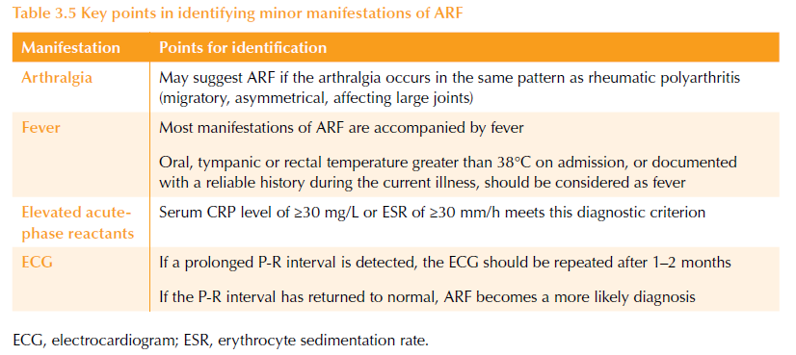
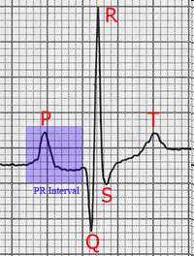
minor manifestations PAGE 37

Slide 12
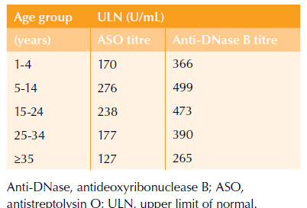
Evidence of strep infection
page 38

Slide 13
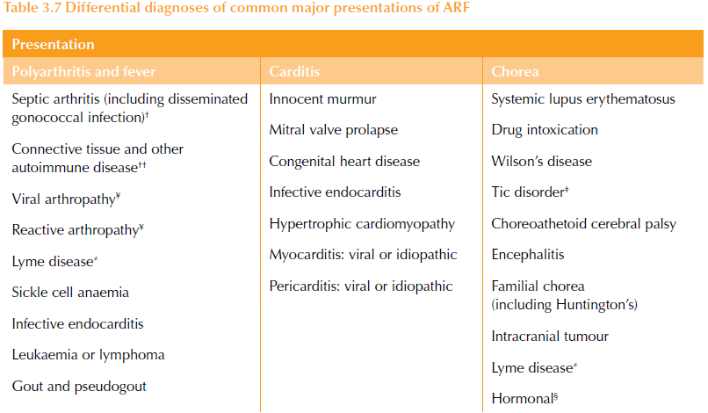
page 39

Slide 15
considerations
If arthritis is a MAJOR, arthralgia cannot be counted in the same person as a MINOR
If carditis is a MAJOR, prolonged PR cannot be counted in the same person as a MINOR
ARF symptoms within 3 months of start of symptoms is the same ARF illness

Slide 16
‘probable’ ARF
Page 47
“A clinical presentation that falls short by either one major or one minor manifestation, or in the absence of streptococcal serology results, but one in which ARF is considered the most likely diagnosis.”
Highly suspected ARF
  manage as ARF
Uncertain ARF
secondary prophylaxis for 12 months
medical assessment (echocardiogram if available)
reassess…

Slide 17
delayed presentation
Mild and/or transient symptoms
Lack of understanding/awareness of ARF among patient & family
Transport difficulties
Poor family support for patient
Other life priorities
Reluctance to use the health facility
Cultural reasons
… many more…

Slide 18
delayed diagnosis
Lack of training/awareness of ARF
Atypical presentation (misdiagnosis)
Miscommunication
    insufficient clinical history /poor history taking skills
    language gap
    misinterpretations and wrong assumptions
Lack of diagnostic tools
Poor referral systems
Lack of 'human resources' to spend time with the patient

Slide 19
Mangement of ARF page 44

Slide 20
principles of treatment
Once the diagnosis has been established (or highly suspected):
    Routine treatment - for everyone
    Specific treatment - for symptoms
    Six-point management plan

Slide 21
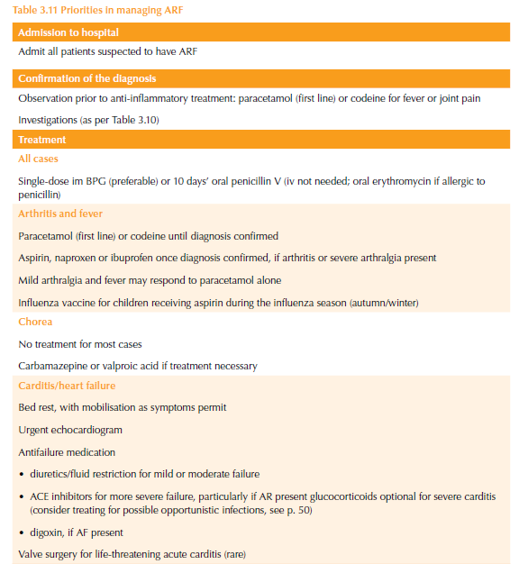

Slide 25
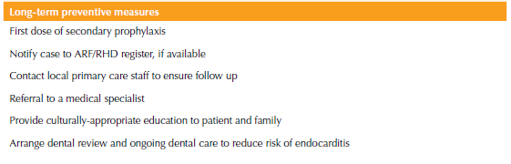
mangement plan
Page 44
Revisit RHD management plan if existing RHD (from previous ARF)

