Slide 1
-
Improving Aboriginal Patient journeys
SA RHD Education Workshop
30 March 2017
Janet Kelly
Wardliparingga Aboriginal Health Research Unit, SAHMRI

Slide 2
Acknowledgements
Kaurna people and land
Aboriginal patients and their families
Aboriginal and non-Aboriginal clinical and support staff
Managing Two Worlds Together project
  Based at Flinders University
  Funding Lowitja Institute & SA Health

Slide 3
Aboriginal patient journeys
Are often complex and require consideration of:
  personal, social, family, cultural, community needs
  clinical complexities, comorbidities
  access and quality of care
  communication, coordination, collaboration, cultural safety
“Usual care” may not meet patient’s needs
  Equity Vs equality

Slide 4
MTWT project
City hospital care for country Aboriginal patients
Stage 1
Understanding the problems
Interviews with patients and staff
2008-11
Stage 2
Exploring solutions& strategies
Action projects
2012
Stage 3
Improving journeys
Adapting and testing patient journey mapping tools
2013-15
Notes:
Aim:To improve knowledge of what works well and what needs improvement in the system of care for Aboriginal patients from rural and remote areas of South Australia
1 – 6 main reasons country Aboriginal people were admitted to city hospitals – cardiac, respiratory, mental health, birthing, injury, renal/endocrine

Slide 5
Mapping journeys
We developed tools that enable us to:
Understand what is happening for patients, families & staff
Make journeys and complexities more visible
Identify gaps and strengths
Identify strategies to improve care experiences and outcomes

Slide 6
Mapping tools
Narrative – story of the journey
Visual – drawing of the journey
Tables with trigger questions
  Whole person entering the journey
  Underlying factors to access and quality
  Multiple perspectives
Findings
Comparison with standards, action plan

Slide 7
Narrative
Telling the patient journey story from patient and family member’s perspective

Slide 8
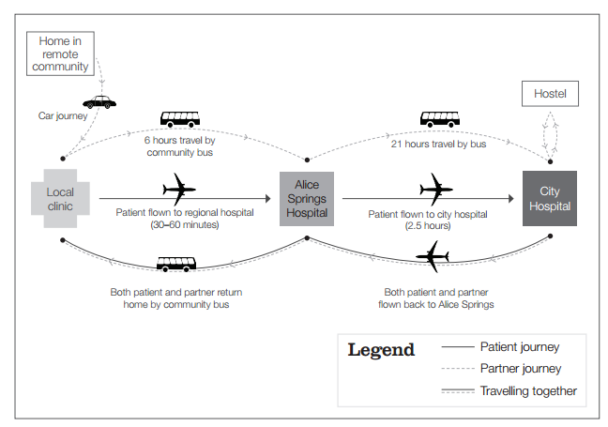
Visual

Slide 9
Dimensions of health
Health
Social & emotional
Family & community
Personal, spiritual, cultural
Physical & biological

Slide 10
Underlying factors that impact on access & quality of care
Location, travel,
accommodation
Impact of illness
Communication & language
Financial resources
Cultural safety

Slide 11
Chronological mapping: bringing all perspectives together
 | Patient history | Diagnosis / referral | Trip to city | Pre-admission | In hospital | Discharge / Transfer | Trip home | Follow up
Patient journey
Family / carer journey
Pt priorities & concerns
Health care priorities & concerns
Service gaps
Responses to gaps

Slide 12
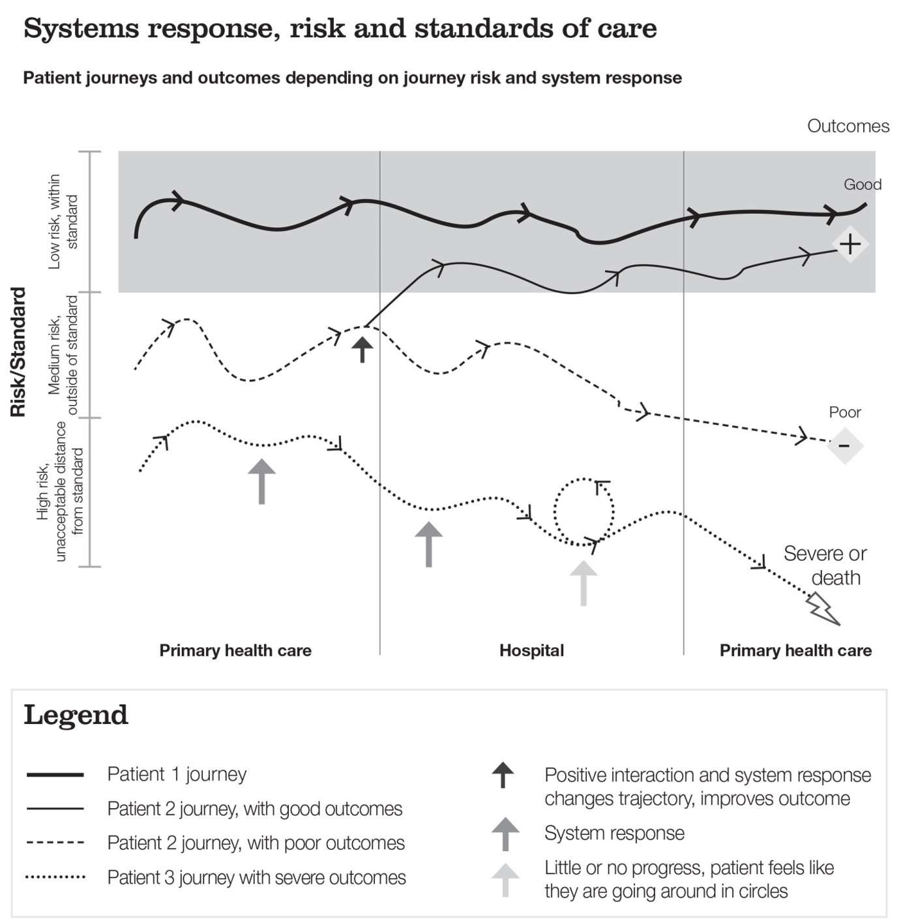
Comparing the journey to standards

Slide 13
Taking action
Issue | Level | Action | By whom | When | How | Review date
Improve communication | Personal
 | Professional
 | Service
 | System
Notes:
Deciding how best to share the findings, with whom and in what format?
Case studies – wards/units, education,
Published articles
Presentations

Slide 14
Thankyou
Janet Kelly
Janet.Kelly@Sahmri.com

