Slide 1
Rheumatic Heart Disease in Pregnancy
Dr. Carrmen Chung
Service Registrar, Lyell McEwin Hospital
MBBS (Hons.)

Slide 2
Objectives
Understand how RHD impacts on the health of a pregnant women
Appreciate the significance of rheumatic valve disease in pregnancy
Understand anticoagulation issues in pregnant women
Appreciate the importance of pre-conception counselling for women with ARF and RHD
Know where to locate information on best-practice approaches to pregnancy and ARF/RH

Slide 3

Physiological changes
CO, ventricular volume
vascular resistance
CO = HR x SV
Notes:
CO increases as early as the 6th week of pregnancy and averages 50% by the end of 2T
Maintenance of adequate oxygen delivery to maternal peripheral rissues as well as to the fetus is achieved through changes in maternal circulating blood volume, red cell mass, vascular compliance, resistance and heart rate.

Slide 4
Antepartum care
Gestational age | What to consider?
First trimester | - Early dating scan for EDD - Multidisciplinary team input
Second trimester | Tertiary centre referral for delivery planning Regular antenatal clinic visits Echocardiogram and cardiology review of functional cardiac status Anaesthetic review
Third trimester | Maternal concerns - heart failure, atrial arrhythmias. Need to treat these if and as they present Fetal concerns - fetal growth restriction. Use fetal ultrasound to assess growth, umbilical artery doppler and AFI

Slide 5
Labour
Intrapartum
    Mode of delivery whether vaginal delivery, assisted vaginal delivery or Caesareans sections are by obstetric indications.
    Unless in cases of pulmonary hypertension – delivery at a facility with cardiology, obstetrics and cardiothoracics, cardiac anesthetist present ie FMC
    Intrapartum monitoring
      NYHA I and II: Labour ward
      NYHA III and IV: Invasive monitoring in labour in ICU
    Analgesia is important

Slide 6
Valvular disease
Gold standard for diagnosis – Echocardiogram
Management
  Exercise within limits, limit fluid and salt intake
  If poor functional tolerance, consider using B adrenergic blockers to decrease tachycardia
  Surgical management: percutaenous valvotomy after 20 weeks gestation only in symptomatic patients with severe pulmonary hypertension
Complications: Pulmonary oedema, heart failure, atrial fibrillation
  Most dangerous period: 28-30 weeks and third stage of labour and delivery; loss of placental bed circulation, overload to maternal circulation.
  Close observation is needed in 24 hours post partum

Slide 7
Mitral stenosis (MS)
Maternal risk
  MS is responsible for most of the morbidity and mortality of rheumatic heart disease during pregnancy.
Obstetric and offspring risk
  Acute heart failure during or just after delivery, prematurity rates are 20–30%, intrauterine growth restriction 5–20%, and stillbirth 1–3%.
Notes:
Medical therapy. When symptoms or pulmonary hypertension (echocardiographically estimated systolic PAP .50 mmHg) develop, activity should be restricted and b1-selective blockers commenced.7,64 Diuretics may be used if symptoms persist, avoiding high doses.64 Therapeutic anticoagulation is recommended in the case of paroxysmal or permanent AF, left atrial thrombosis, or prior embolism.7,64 It should also be considered in women with moderate or severe MS and spontaneous echocardiographic contrast in the left atrium, large left atrium (≥40 mL/m2 ), low CO, or congestive heart failure, because these women are at very high thrombo-embolic risk. Interventions during pregnancy. Percutaneous mitral commissurotomy is preferably performed after 20 weeks gestation. It should only be considered in women with NYHA class III/IV and/or estimated systolic PAP .50 mmHg at echocardiography despite optimal medical treatment, in the absence of contraindications and if patient characteristics are suitable.7,64 It should be performed by an experienced operator, and in experienced hands has a low complication rate. Abdominal lead shielding is recommended.7,64 The radiation dose should be minimized by keeping screening time as short as possible.7,64 Given the risk of complications, percutaneous mitral commissurotomy should not be performed in asymptomatic patients. Closed commissurotomy remains an alternative in developing countries when percutaneous commissurotomy is not available. Open-heart surgery should be reserved for cases in which all other measures fail and the mother’s life is threatened. Delivery. Vaginal delivery should be considered in patients with mild MS, and in patients with moderate or severe MS in NYHA class I/II without pulmonary hypertension. Caesarean section is considered in patients with moderate or severe MS who are in NYHA class III/ IV or have pulmonary hypertension despite medical therapy, in whom percutaneous mitral commissurotomy cannot be performed or has failed.

Slide 8
Aortic Stenosis (AS)
Maternal and neonatal risks
  Maternal mortality associated with severe aortic stenosis is 17 % with a fetal mortality of 32 %
  Obstetric complications in severe AS - hypertension-related disorders in 13%, premature labour, pre-term birth, intrauterine growth retardation, and low birth weight
Notes:
Women with bicuspid aortic valve have a risk of aortic dilatation and dissection

Slide 9
Mitral and aortic regurgitation
Can improve in pregnancy due to the physiological reduction in systemic vascular resistance hence decreasing regurgitant volume
Be cautious post partum as may worsen after delivery because of the increase in vascular resistance

Slide 10
Post partum
At risk if developed heart failure during pregnancy as they are intolerant of changes in vascular resistance.
  Be wary of changes in vasodilatation from oxytocin.
Oxytocin for third stage management in small aliquots 1U 30 seconds apart
Oxytocin infusion diluted in 100ml bag of sodium chloride instead of 1 L

Slide 11
Anticoagulation if needed
Indications:
  Paroxysmal or permanent AF, left atrial thrombosis, can be considered in women with moderate or severe MS and large left atrium (≥40 mL/m2 ), because these women are at very high thrombo-embolic risk.
Increased risk of miscarriage and of haemorrhagic complications
OACs cross the placenta and their use in the first trimester can result in embryopathy - 0.6–10% of cases, 1% have CNS abnormalities
  Use UFH and LMWH - do not cross the placenta and embryopathy does not occur.
Notes:
Increased risk of miscarriage and of haemorrhagic complications, including retroplacental bleeding leading to premature birth and fetal death.

Slide 12
Impact on the pregnant mother
Emotional : Stress, respecting birth plans/wishes
Social : Travelling for appointments and tests
Physical : Delivery and labour, antenatal/cardiology appointments, investigations
Psychological : Delivering in ICU
Pregnancy: High risk – needing multidisciplinary input

Slide 13
Summary
Early identification
Multi-disciplinary approach
Tertiary centre for birth
Intrapartum care
Post partum monitoring

Slide 14


Slide 15
The information gathered could aid in stratifying and managing these women throughout their antenatal, intra-partum and post-natal period.
This is to aid in the development of management guidelines and protocols
Currently ethics approved at the LMH and recruitment has begun
Registry managers and data custodians include myself, Associate Prof Margaret Arstall and Ms Emily Aldridge
Notes:
The spectrum of cardiac disease in the population varies significantly.

Slide 16
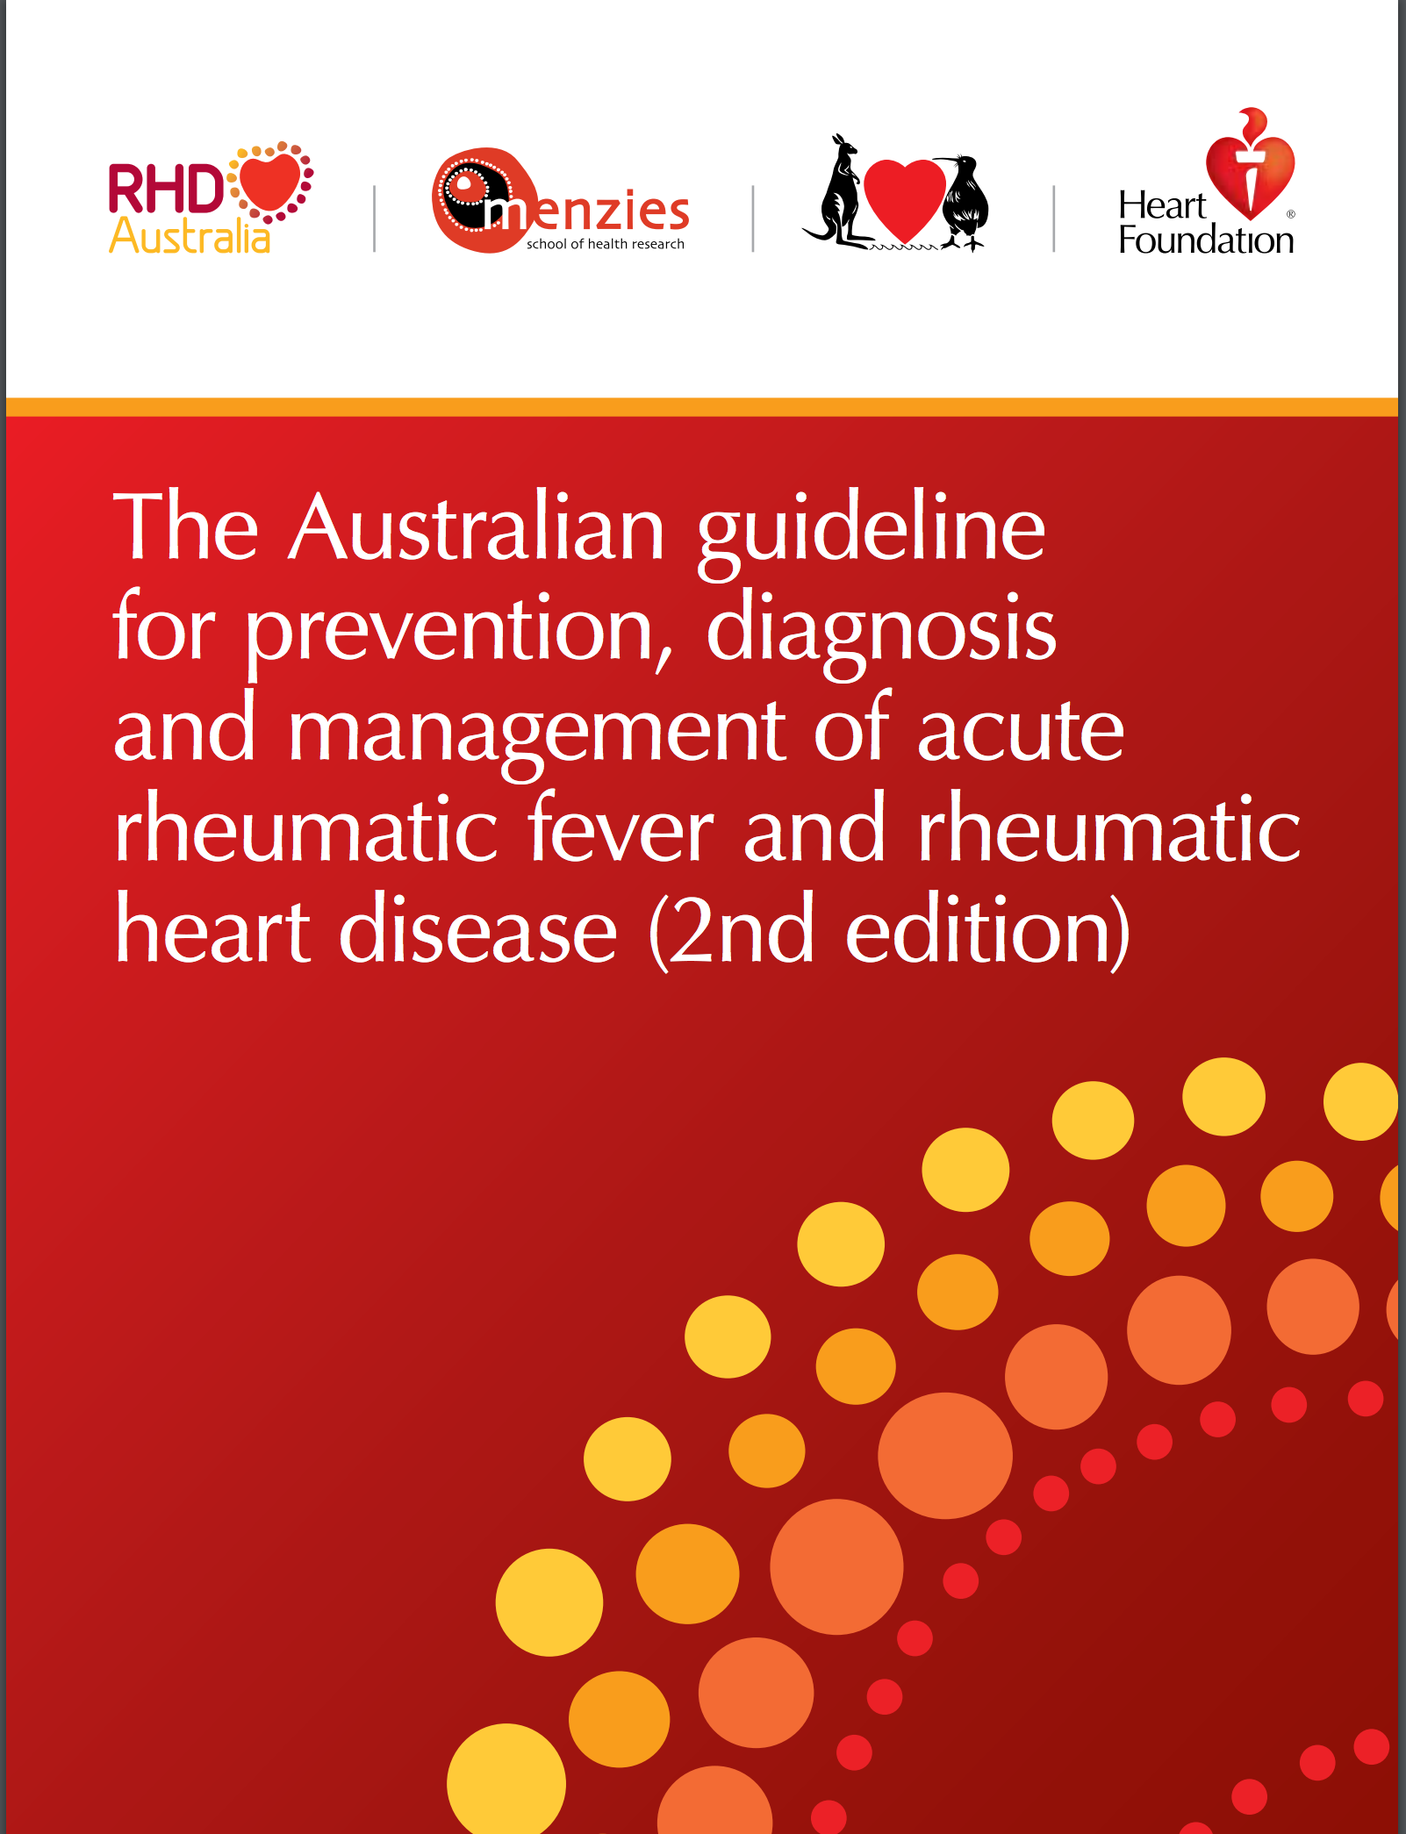
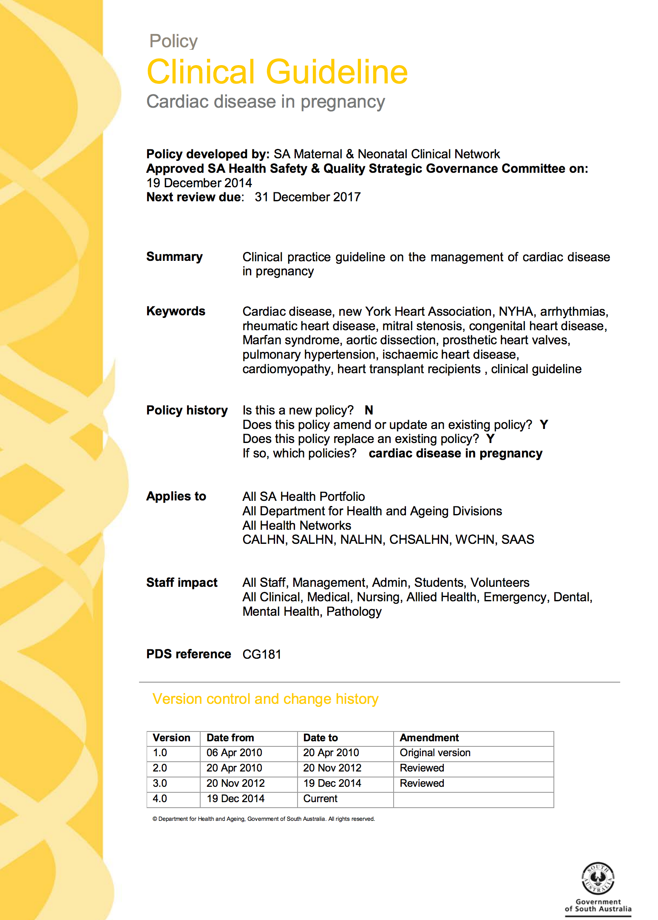
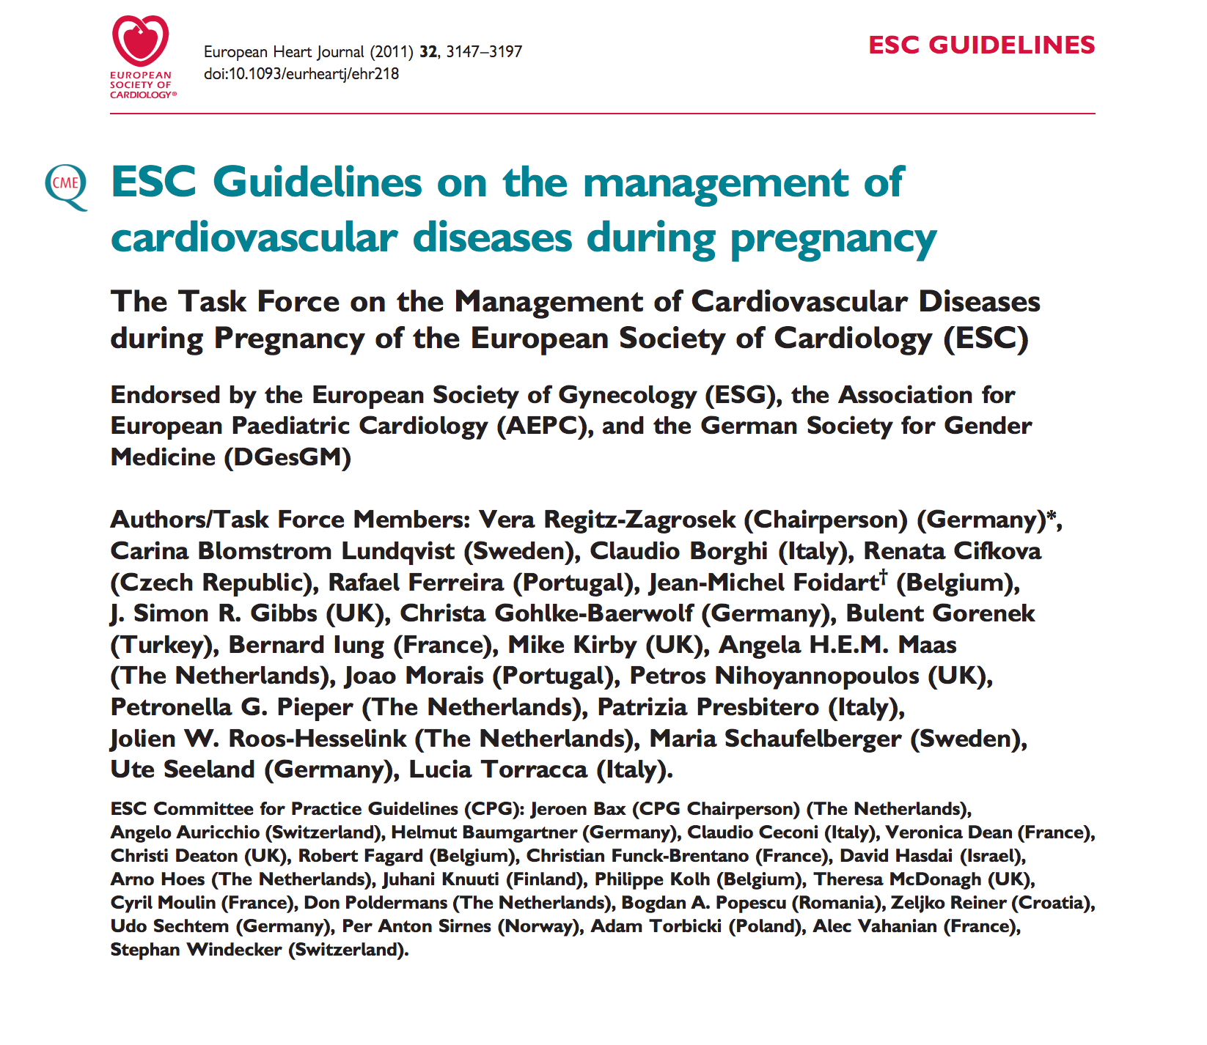


Slide 17
References/ Resources
RHD Australia at http://www.rhdaustralia.org.au/
South Australian Perinatal Practice Guidelines: Cardiac disease in pregnancy. http://www.sahealth.sa.gov.au/wps/wcm/connect/c88d89804ee1e907af07afd150ce4f37/Cardiac+disease_Clinical+Guideline_final_Dec14.pdf?MOD=AJPERES&CACHEID=c88d89804ee1e907af07afd150ce4f37
Rheumatic heart disease in pregnancy. Australasian Maternity Outcomes Surveillance System. http://amoss.com.au/sites/default/files/AMOSS_RHD-P_Flier_20160404.pdf
Marijon E, Mirabel M, Celermajer DS, Jouven X. Lancet 2012, 379:953-64Seminar: Rheumatic heart disease.
EHC guidelines on the management of cardiovascular diseases during pregnancy. European Heart Journal 2011, 32, 3147- 2197

