Slide 1
Diagnosis and Management of Rheumatic Heart Disease
Dr Andrew Kelly
Paediatric Cardiologist
Women’s & Children’s Hospital
with thanks to Sara Noonan and RHD Australia for slides

Slide 2
Learning objectives
Understand the best approaches to prevention, diagnosis and management of RHD
Identify the aims and function of control programs
Know where to locate information on best-practice approaches to the prevention, diagnosis and management of RHD

Slide 3
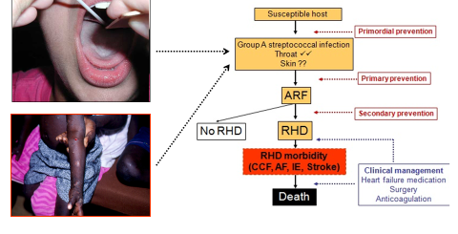
Tertiary prevention of RHD
Tertiary prevention refers to prevention of morbidity and mortality and therefore prevention of complications of RHD

Slide 4

What is rheumatic heart disease?

Slide 5
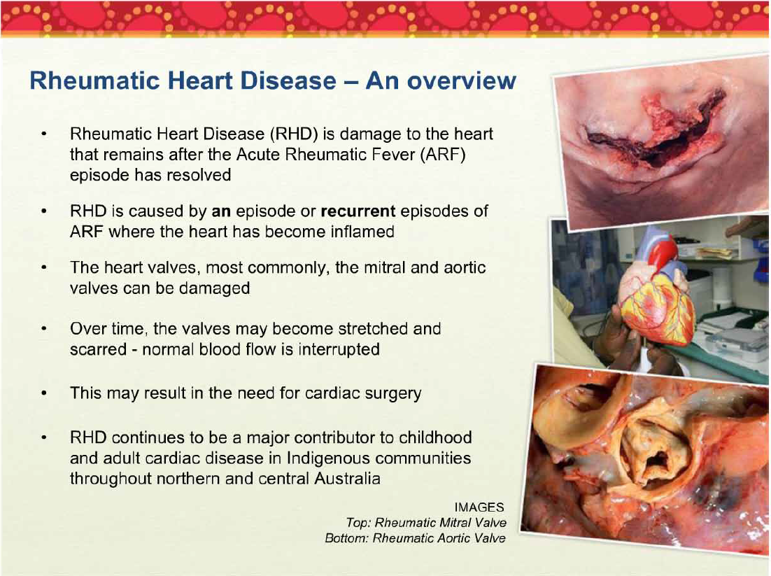

Slide 6
What is RHD?
Natural history of disease if adequate
secondary prevention is not given
Example age timeline (years)
ARF episodes make valve(s) inflamed.
The valve is left damaged and scarred. May cause leakage then later, blockage, or both.
Leaking valves: heart chambers get stretched. Blocked valves: heart muscle struggles hard to move blood forwards
Heart failure starts to develop. The patient may develop symptoms including breathlessness.
Heart medications are needed. Eventually, valve surgery may be needed.
5
10
13
15
16
Notes:
Natural history od disease if secondary prevention is not given

Slide 7
Further RHD progress
Example age timeline (years)
Next surgical step may be valve replacement.
If a metal valve is used, or the heart develops fibrillation, then the person needs warfarin treatment
Too much warfarin can cause haemorrhage. Not enough can cause stroke. Either of these can be fatal.
Valves which are scarred or operated on a prone to infection (endocarditis). This can also be fatal.
First surgical step may be valve repair
16
21
21
28
30

Slide 8
Which valves are affected?
Mitral valve is affected in over 90% of cases of RHD
  Mitral regurgitation most commonly found in children & adolescents
  Mitral stenosis represents longer term chronic disease, commonly in adults
  Most common complication of mitral stenosis is atrial fibrillation
Aortic valve next most commonly affected
  Often occurs with disease of the mitral valve.
  Stenosis tends to develop as a long term complication of aortic regurgitation
Tricuspid and pulmonary valves are much less commonly affected
  Usually affected in very severe RHD when all valves are affected

Slide 9
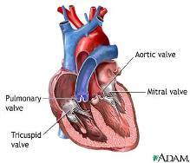
Signs and symptoms
Symptoms of RHD may not develop for many years
  A murmur but no symptoms suggests mild or moderate disease
    Patients may not realize they need medical help; may think symptoms are normal
  Symptoms usually suggest more severe disease
Symptoms depend upon the type and severity of disease e.g.
  Breathlessness with exertion or when lying down flat
  Waking at night feeling breathless
  Tiredness
  Leg swelling (peripheral oedema)
  Palpitations if atrial fibrillation or other rhythm problem develops
Sudden onset of symptoms may occur
  New ARF episode with carditis
  pregnancy / labour
  rupture of valve cord

Slide 10
Does ARF always led to RHD?
No. RHD is more likely if:
  Heart is affected in ARF (carditis)
  ARF is severe
  ARF occurs at a young age
  Recurrent ARF episodes occur
However, you can’t accurately predict who will go on to develop recurrent ARF and RHD
  hence EVERYONE who has had ARF, even if there was no carditis, needs secondary prophylaxis with long-term penicillin.

Slide 11

Complications of rheumatic heart disease

Slide 12
Complications of RHD
Atrial fibrillation
  Common in RHD
  Causes irregular heart rate / palpitations, blackouts etc, causes blood clots in atrium which can then cause stroke
Stroke
  Ischaemic stroke (blood clot)
    Due to not enough warfarin, when atrial fibrillation or metal valve are present
    Also can complicate infective endocarditis
  Hemorrhagic stroke (bleed into brain)
    Due to too much warfarin
Heart failure
  Symptoms: shortness of breath, swelling in the legs, cough, fatigue, weakness
Infective endocarditis
  bacterial infection of heart valve – targets damaged valves
  Bacteria get into blood via mouth (especially when dental hygiene is poor), open skin etc
  People at high risk receive endocarditis prophylaxis prior to surgical procedures
  Dental health and hygiene reduces risk of endocarditis

Slide 13
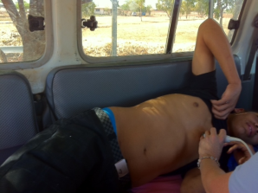
Diagnosis of rheumatic heart disease

Slide 14
Diagnosis of RHD – key principles
High index of suspicion in high risk regions and populations
History and examination are still very important!
Follow the Australian guidelines
Access to echocardiography
Access to specialist opinion
Notes:
content

Slide 15
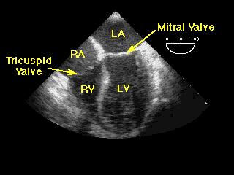
How is RHD diagnosed?
Using echocardiography
(ultrasound of heart)
Required for
  anyone who has had ARF
  anyone in high risk group with a murmur even if they never had known ARF
  for investigation of breathlessness etc
RHD needs to be detected early, before symptoms start
Listening to the heart with the stethoscope is not accurate
  RHD can be present even when you can’t hear a murmur

Slide 16
What if early diagnosis is missed?
ARF is often not diagnosed
May miss the opportunity to start secondary prophylaxis and to prevent further ARF and progression to RHD
RHD may become more advanced, and start causing symptoms
Extra demands on the heart may make the RHD come to light
  Pregnancy or labour
  High-level physical exertion (e.g. footy)

Slide 17
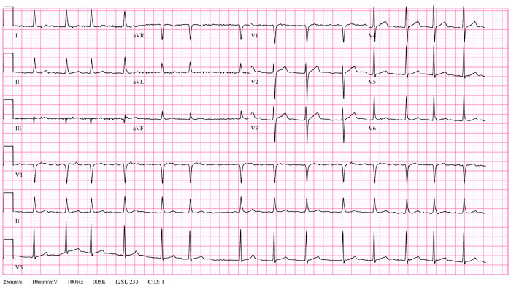
What investigations are needed?
Electrocardiogram (ECG)
  To check rhythm, evidence of hypertrophy etc

Slide 18
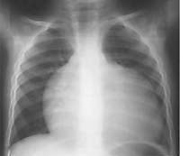
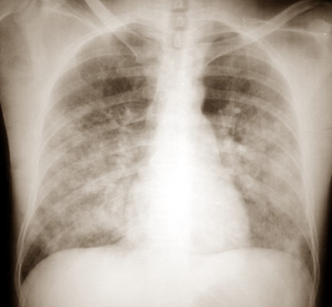
What investigations are needed?
Chest X-ray (CXR)
  To check heart size
  To identify cardiac failure (pulmonary congestion)

Slide 19
What investigations are needed?
Echocardiography
  To identify heart valve damage
  To grade severity of disease
  For serial comparisons over time to monitor progress
Assign severity grade
Classification | Criteria
Priority 1 – SEVERE | Severe valve disease on echo Or Moderate disease on echo with symptoms Or Valve repair or replacement
Priority 2 – MODERATE | Moderate valve lesion on echo without symptoms
Priority 3 – MILD | Mild valvular lesion or ARF without RHD

Slide 20
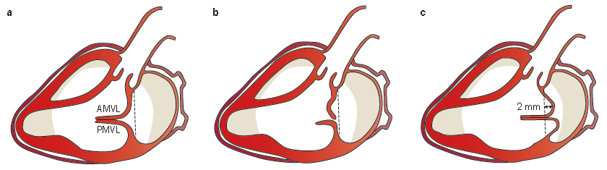
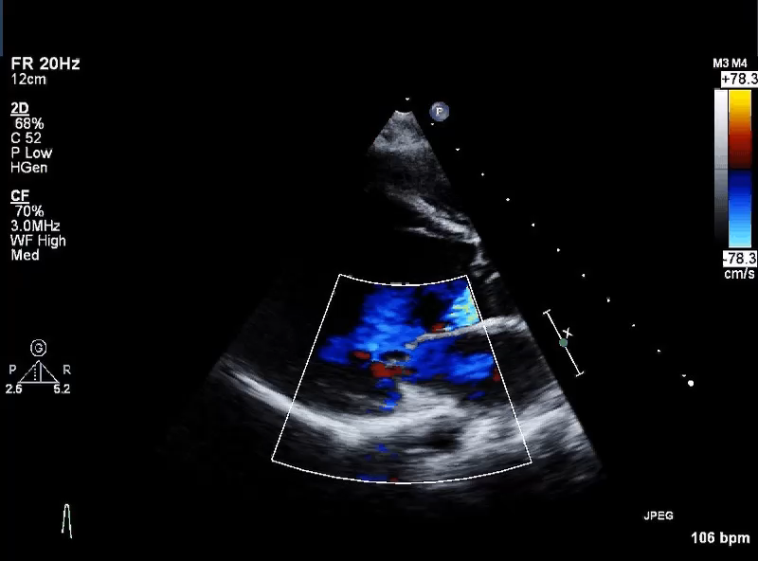
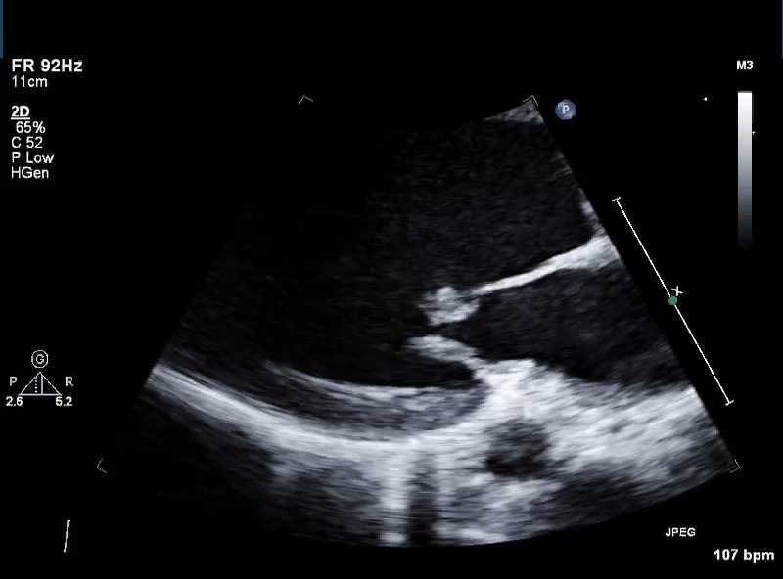
Acute valvulitis
Acute valvulitis
Notes:
Acute RHD with prolapse of AMVL.

Slide 21
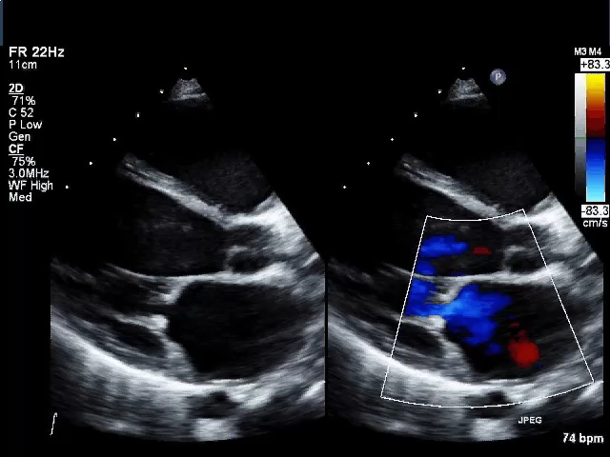
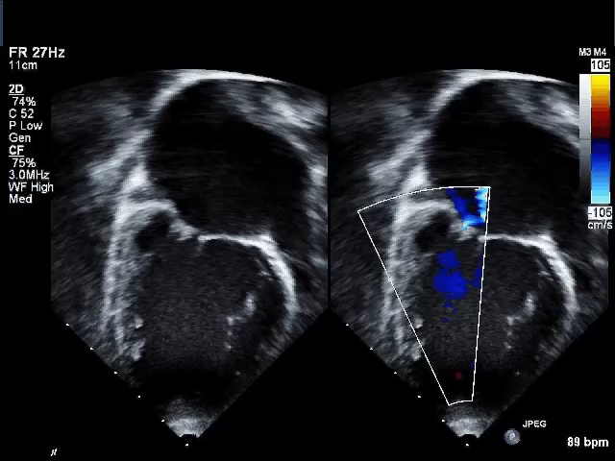
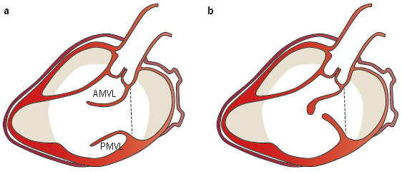
Chronic RHD
Notes:
Chronic mixed MR and MS. Both echoes are from the same patient.

Slide 22
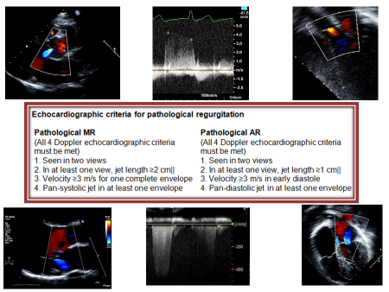
Diagnosis of acute valvulitis

Slide 23
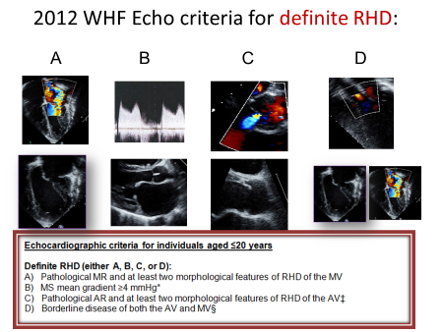
Diagnosis of chronic RHD

Slide 24
Valve appearance in RHD

Slide 25

Management of rheumatic heart disease
CARE PLANNING

Slide 26
Ten-point management plan
1. Register with RHD program
2. Establish or continue secondary prophylaxis
3. Disease education and self-management support
4. Regular clinical review and echocardiogram
5. Regular dental care
6. Management of cardiac symptoms
7. Infective endocarditis prevention
8. Family planning
9. Well-planned surgery
10. Management of pregnancy

Slide 27
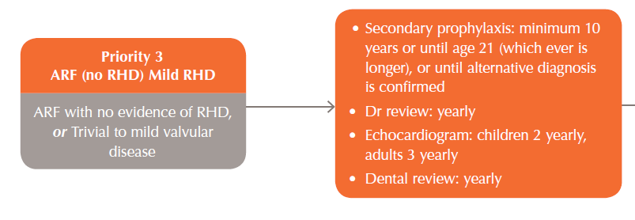
Basic care plan for Priority 3 (Mild) RHD

Slide 28
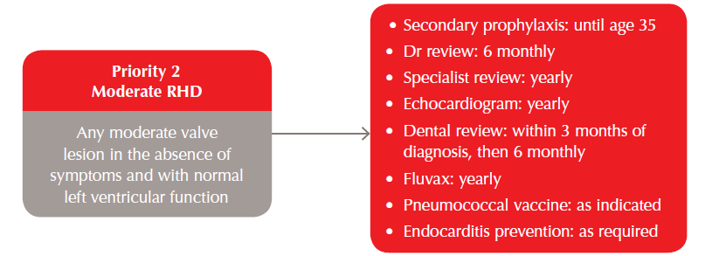
Basic care plan for Priority 2 (Moderate) RHD
Give amoxicillin 2g (adults) 1hr before:
  Dental procedures e.g. extraction, scaling
  Tonsillectomy/adenoidectomy
  Incision & drainage of abscesses
  Surgical procedures through infected skin
  Some genitourinary procedures
  Delivery with long labour

Slide 29
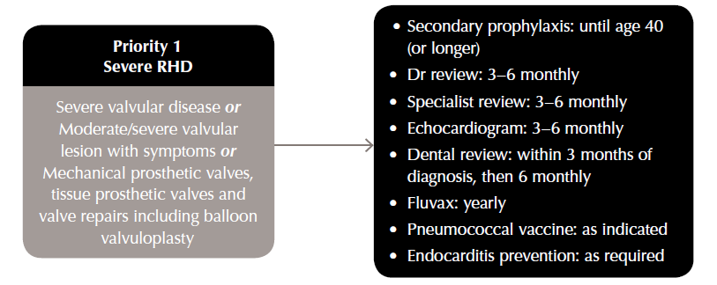
Basic care plan for Priority 1 (Severe) RHD

Slide 30
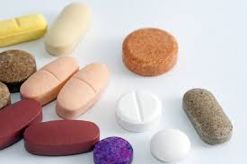
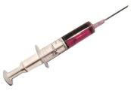
Management of rheumatic heart disease
MEDICAL MANAGEMENT

Slide 31

Tertiary prevention of RHD
Prevention of morbidity and mortality by:
Prevention of acute rheumatic fever recurrence
    - 3-4 weekly Benzathine Penicillin G
    Modification of environment
Heart failure management
    Valve repair
    Valve replacement
    Heart failure medication
Anticoagulation management
    Dilated left atrium
    Atrial fibrillation
    Mechanical valve
Arrhythmia management
    Ablation
    Medication – digoxin
    Anticoagulation
Endocarditis prevention
Prevention of pregnancy related complications

Slide 32
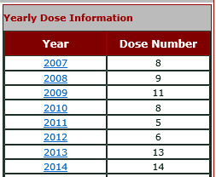
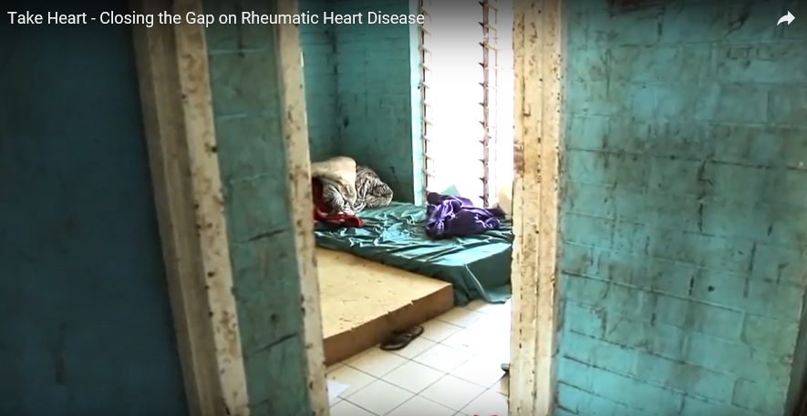
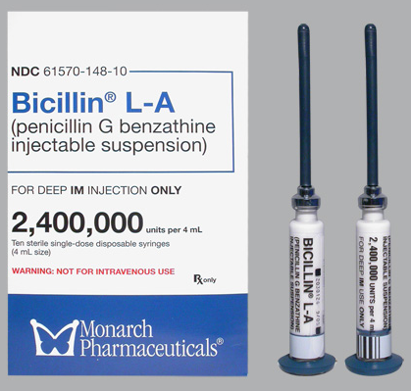
Tertiary prevention of RHD
1. Prevention of acute rheumatic fever recurrence
    3-4 weekly Benzathine Penicillin G
    Modification of environment
      Secondary prophylaxis plus

Slide 33
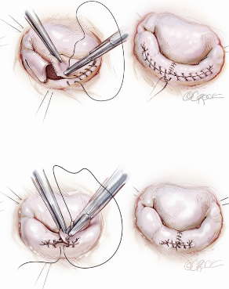
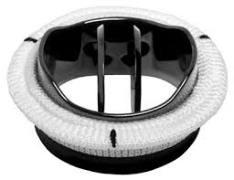
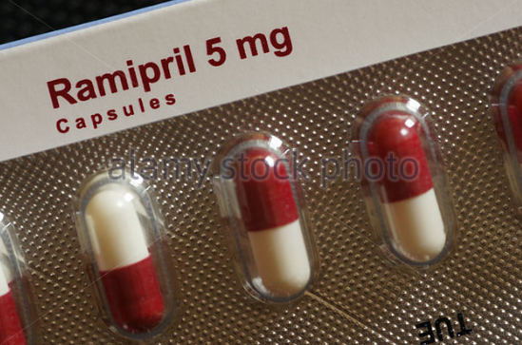
Tertiary prevention of RHD
2. Treatment of heart failure:
    Heart failure medication
    Valve repair
    Valve replacement
1. Medications 2. Repair 3. Replacement

Slide 34
Tertiary prevention of RHD
2. Treatment of heart failure:
The Australian experience with mitral valve repair
Mitral Valve repair
Australian paediatric cohort – RCH Melbourne
Notes:
Survival following mechanical valve replacement following mechanical valve replacement for RHD
This Northern Territory historical data.

Slide 35
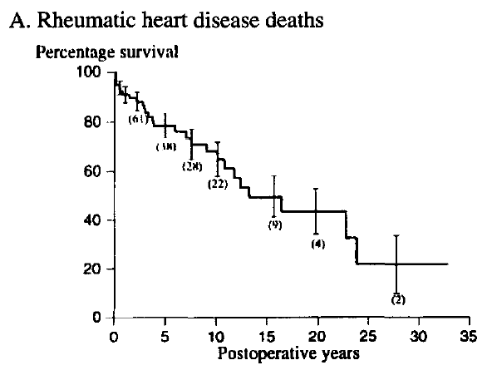
Tertiary prevention of RHD
2. Treatment of heart failure:
The NT experience with valve replacement
Mitral Valve replacement
Carapetis Asia Pacific Heart J. 1999;8:138-47.
Notes:
Survival following mechanical valve replacement following mechanical valve replacement for RHD
This Northern Territory historical data.

Slide 36
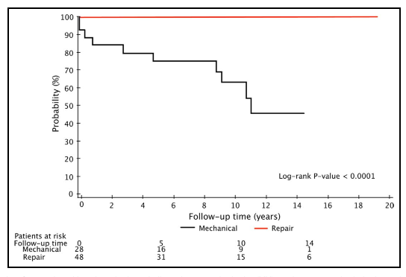


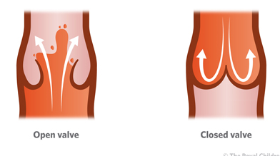
Tertiary prevention of RHD
3. Prevention of stroke - anticoagulation
Anticoagulation management
    Dilated left atrium
    Atrial fibrillation
    Mechanical valve
    Options: Claxane / Warfarin
Why? To prevent:
    A stroke
    Mechanical valve blockage
Survival free of stroke / major bleed
World j. ped cong card surgery 2013 4: 155

Slide 37

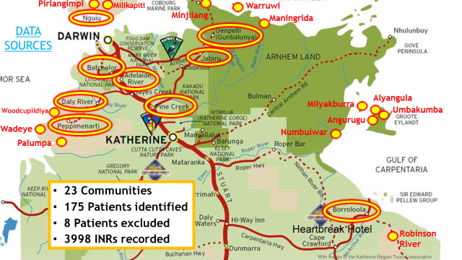
Monitoring of anticoagulation
COMPLICATION | % (n)
TOTAL | 15.0% (25)
Thrombotic | 3.0% (5)
Bleeding | 12.0% (20)
- mild | 7.8% (13)
- severe | 3.6% (6)
- fatal | 0.6% (1)
Careflights | 4.2% (7)
Hospital Visits | 10.2% (17)
ICU admissions | 2.4% (4)
Haemorrhagic Complications
Documented 7.2 major non fatal & 1.3 fatal per 100 patient years in a 2003 meta-analysis of 33 studies
4.2 non-fatal & 0.8 fatal bleeds per 100 patient years within our cohort
Notes:
Study ran for 12 months.
Hence annual complication rate of complication in remote indigenous communities
Adults and children. 50% of patient cohort had RHD.
Very high complication rate. Though NOT dissimilar to other international studies / meta-analyisis

Slide 38
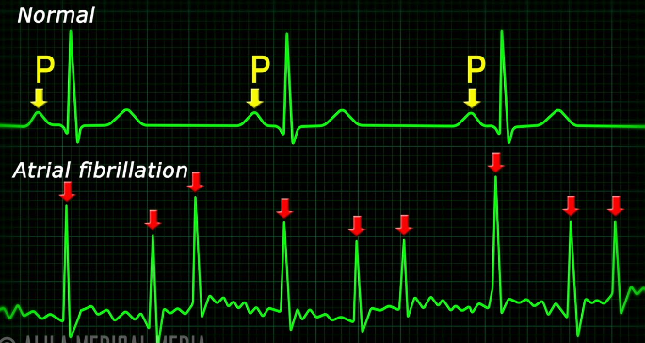
Tertiary prevention of RHD
4. Management of arrhythmias
Arrhythmia management
    Ablation
    Medication – digoxin
    Anticoagulation

Slide 39
Tertiary prevention of RHD
5. Prevention of endocarditis
    Brushing teeth twice daily
    Dental review 6 monthly
    Endocarditis prophylaxis at time of dental procedures

Slide 40
Tertiary prevention of RHD
6. Prevention of pregnancy related complications

Slide 41
Why does RHD get worse in pregnancy?
Normal pregnancy:
  30-50% increase in blood volume
  Increase in heart rate by 10-15 beats per minute
    therefore ‘hyperdynamic circulation’; major extra cardiac work needed.
  Labour – further major increase in cardiac work needed
If heart capacity is reduced due to RHD, then breathlessness and heart failure can occur

Slide 42

Pregnancy:
Careful planning, careful management
Contraception to allow for careful planning
Education: risks for mother / risk for baby
Advice / decision on anticoagulation
Warfarin - tablets | Clexane injection | Heparin infusion
Safest for mother | Safest for baby | Not an option to stay on infusion for 40 weeks
Miscarriage, late foetal loss -30% Embryopathy- birth defects – 8% -greatest risk 6-12 weeks | 20% risk of valve blockage Peri-partum haemorrhage
Option1:
Clexane 0- 13 weeks
Warfarin 14-36 weeks
Then Clexane
Option 2:
Warfarin until 36 weeks
Then Clexane

Slide 43
Optimally manage comorbidites; prevent added health problems
Make sure any comorbidities are properly managed
Make sure preventive medicine is used effectively
  RHD patients at risk of other communicable disease, and may poorly tolerate added burden of illness
    Pap smears
    STI avoidance
    Quit smoking assistance
    Weight loss assistance

Slide 44
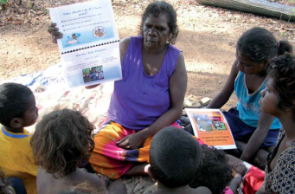
Management:
Education and self management support

Slide 45
Education & self-management support
Formal sit-down discussion with patient and all relevant kin
Provide information in patient’s own language
Use RHD Australia resources
Use self-management support tools
Tailor to the individual’s age, education, level of disease
Offer hope and encouragement
Different health staff need to give consistent, accurate messages

Slide 46
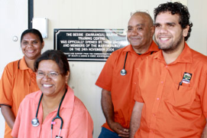
Role of the primary care provider in RHD care

Slide 47
Role of the primary care provider
Coordinate the RHD care plan
  Secondary prophylaxis
  Specialist medical and dental appointments
  Oral medications - making sure prescriptions are up to date, support adherence, monitor for side effects
  Make sure INRs checked for warfarinised patients
Support, educate, encourage
  Improve health literacy for patients and their families
Understand the psychological consequences of being labelled with a chronic disease in childhood/adolescence

Slide 48

Role of a RHD Register in RHD care

Slide 49
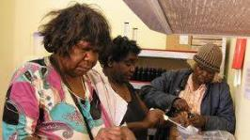
Objectives of register-based prevention program
1. Ensure success of 2^{ry} prophylaxis by
  Providing lists of people for secondary prophylaxis
  Identifying when secondary prophylaxis is not being delivered and feeding information back to clinic
2. Facilitate coordination of ongoing care by
  Generating regular reports to enable recall and review
  Ensuring that patients are not lost to follow-up
  Facilitating health education
3. Provide epidemiological data:
  To monitor ARF/RHD incidence / prevalence
  For program evaluation

Slide 50
Take-home messages
Prevent RHD from occurring
Prevent existing RHD from getting worse
Diagnose RHD early, before it starts causing symptoms
Through repeated education sessions with the patient and their family, make sure the patient understands that
  RHD is very serious, but
  No matter how severe, there are good treatment options
  Further worsening can be minimised with regular secondary prophylaxis
  Having a valve replaced doesn’t mean that secondary prophylaxis can be stopped

Slide 51
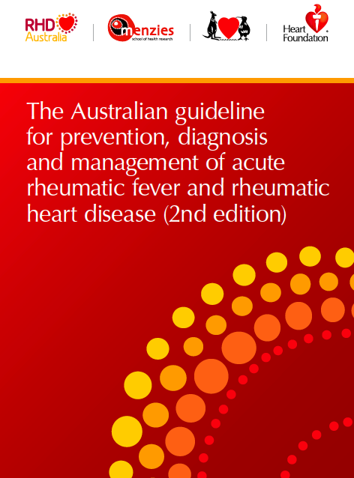
Resources
RHD Australia Training modules http://rhdatest.docebosaas.com
National Guideline and RHD Australia patient and staff educational materials http://www.rhdaustralia.org.au/resources

Slide 53
Extra slides

Slide 54

Objectives of register-based prevention program
First objective
To ensure the successful provision of secondary prophylaxis by:
  Updating, generating and distributing community lists of people recommended for secondary prophylaxis
  Identifying when secondary prophylaxis is not being delivered appropriately and feeding the information back to primary care services
  Targeting resources and devising new approaches in service delivery
With permission
Notes:
Out of the various documents

Slide 55
Objectives of register-based prevention program
Second Objective
To facilitate coordination of ongoing care for people with ARF/RHD by:
  Recording details of people who require follow-up
  Generating regular reports to enable timely recall and review
  Ensuring that people with ARF/RHD are not lost to follow-up
  Facilitating health education of healthcare staff, people with ARF/RHD, their families and the community
Notes:
Recording the details of people who require follow-up according to best practice guidelines at community and specialist levels
Generating regular reports for health clinics and clincians to assist timely recall and review
Facilitating health education for both health workers and population at risk

Slide 56

Objectives of register-based prevention program
Third Objective
To provide epidemiological data:
  To monitor the incidence and prevalence of ARF and RHD in each region
  For program evaluation
  To identify research needs
  To set priorities for the program

Slide 57
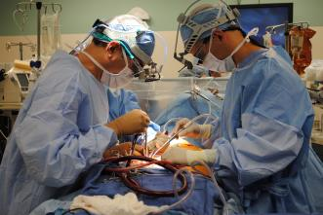
Management of rheumatic heart disease
3. Surgery

Slide 58
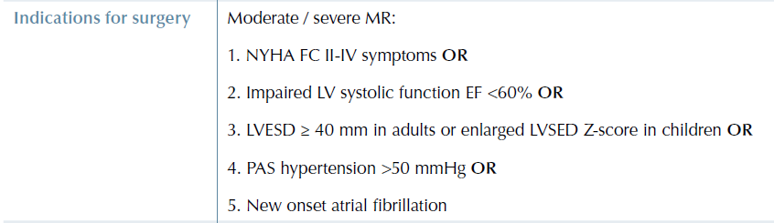
Planning surgery
Should be well planned, based on good monitoring. Much better to avoid emergency surgery
The need for heart valve surgery depends on echo criteria
Steps to take before surgery
  Lots of family education, consultation, chance to ask questions, get psychologically prepared
  Complete dental assessment and treatment (if required)
  Review and best management of other health problems (e.g. kidney, vascular and chronic respiratory disease, cancers and obesity)
  Make sure vaccinations are up to date
  Arrange an escort and accommodation for the escort

Slide 59



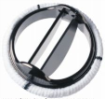
Selecting surgery type for mitral valve
Valve repair
(for mitral regurgitation)
If replacement can’t be avoided, tissue valve preferred
If metal valve + warfarin are essential, ensure education including contraception
Percutaneous balloon valvuloplasty
(for mitral stenosis)

Slide 60
Surgical options
Heart valves can be repaired or replaced
Heart valve REPLACEMENT
Heart valve REPAIR
Anticoagulation required
Longer time before re-operation
No Anticoagulation
Shorter time before re-operation
RHD

Slide 61

Management of rheumatic heart disease in pregnancy

Slide 62
Note: Diltiazem and ACEI (e.g. ramipril) contraindicated in pregnancy
Overview of RHD management in pregnancy
Avoiding
pregnancy
Labour
Contraception e.g. OCP, Implanon
Temporary valve repair if surgery indicated
Optimise medical management
Once pregnant: refer to high-risk O&G clinic.
Serial echos
Avoid over-exertion; salt/fluid overload
Keep going with secondary prophylaxis
Check vaccinations up to date
Replace warfarin with LMWH in weeks 6-12 and after week 36
Complex – see guidelines
Anticoagulated: timed labour induction or elective caesar
Non-anticoagulated: can try normal delivery
Careful monitoring in labour
Endocarditis prophylaxis when indicated
2 days post-partum, resume warfarin
Trying for
pregnancy
Pregnant

Slide 63

Types of valve disease
Valve regurgitation = leakage. Valve leaflets do not meet in the middle.
Valve stenosis = blockage to blood flow. Valve leaflets become hard and fixed in place.

